Slide 1
SAMPLE COMPANY REPORT
Project portfolio
report
Separate sample scenarios for project progress, budgets, resource capacity and risk
14 projects
4 projects
60 items
Progress sample
Budget sample
Risk sample
Notes:
Separate sample scenarios for project progress, budgets, resource capacity and risk
All figures are sample data. Charts are native PowerPoint objects with self-contained sample values, not live workbook links. Enter Slide Show to play fade effects.

Slide 2
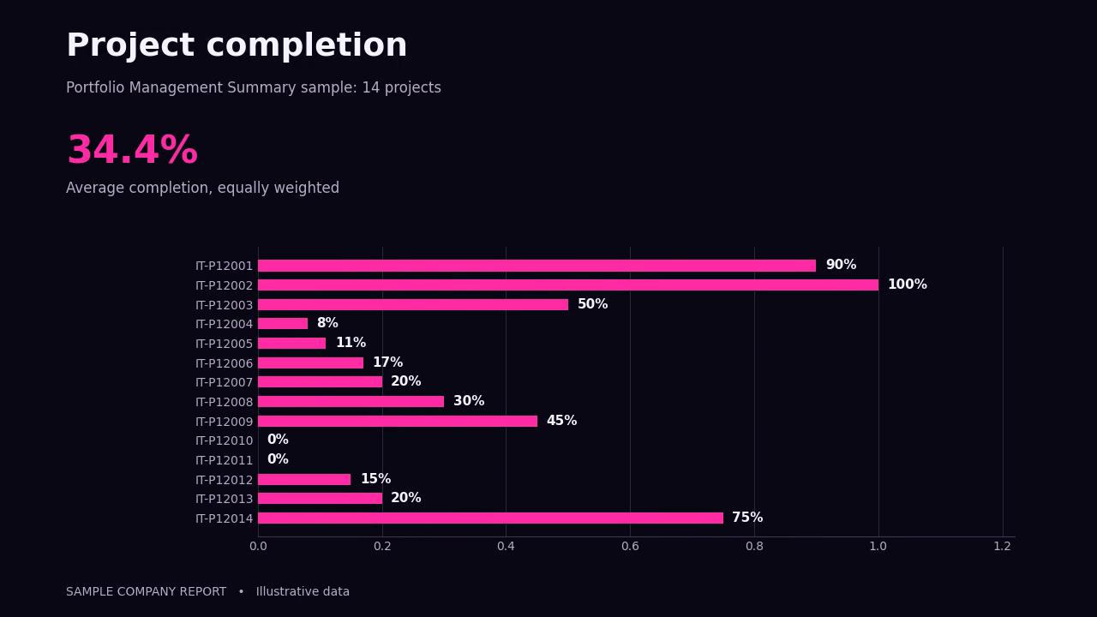
Animated report — play in Slide Show
Notes:
Embedded H.264 animation. Starts on entry in Slide Show. Click the video if your PowerPoint playback settings require it.
All figures are sample data. Charts are native PowerPoint objects with self-contained sample values, not live workbook links. Enter Slide Show to play fade effects.

Slide 3
Project status
Projects
In progress
Complete
Average completion
14
3
1
34.4%
Category | Count | Share
On Hold | 1 | 7.1%
Complete | 1 | 7.1%
In Progress | 3 | 21.4%
Planning | 2 | 14.3%
Approved | 2 | 14.3%
Proposed | 1 | 7.1%
Monitor | 2 | 14.3%
Requested | 2 | 14.3%
Sample scenario: Portfolio Management Summary workbook.
03
Notes:
Source: IC-Project-Portfolio-Management-Summary-Dashboard.xlsx, EXAMPLE sheet, rows 18–31. Status counts total 14. Average completion is the unweighted arithmetic mean, 34.3571%.
All figures are sample data. Charts are native PowerPoint objects with self-contained sample values, not live workbook links. Enter Slide Show to play fade effects.

Slide 4
Completion by project
14 sample projects. Completion percentages come from the source workbook.
04
Notes:
Source: IC-Project-Portfolio-Management-Summary-Dashboard.xlsx, EXAMPLE sheet, N18:N31, IDs D18:D31. Two charts show all 14 source records.
All figures are sample data. Charts are native PowerPoint objects with self-contained sample values, not live workbook links. Enter Slide Show to play fade effects.

Slide 5
Budget compared with actual spend
Planned budget
Actual spend
Unspent budget
Budget used
$196,700
$170,215
$26,485
86.5%
Separate sample scenario: Portfolio Budget Tracking workbook. Dollar notation follows the template.
05
Notes:
Source: IC-Project-Portfolio-Dashboard-with-Budget-Tracking-Template-12221.xlsx, example sheet. Project subtotals at S/T rows 25,39,53,67. Planned 196700, actual 170215, difference 26485, utilization 86.5353%. Projects 1 and 3 exceed budget by $770 each. Unspent balance is not a forecast of savings.
All figures are sample data. Charts are native PowerPoint objects with self-contained sample values, not live workbook links. Enter Slide Show to play fade effects.

Slide 6
Capacity and billable hours
Capacity hours
Projected hours
Achieved hours
Actual utilization
67,000
82,941
95,171
142.0%
Separate sample scenario: Resource Utilization workbook. First 12 sample periods.
06
Notes:
Source: IC-Resource-Utilization-Project-Portfolio-Dashboard-Template-12221.xlsx. First 12 periods C:N; capacity row27, projected28, achieved29. Ratio of totals 95171/67000=142.0463%, not the average of monthly percentages. Values over 100% indicate reported hours exceeding stated capacity. Fictional dates are omitted.
All figures are sample data. Charts are native PowerPoint objects with self-contained sample values, not live workbook links. Enter Slide Show to play fade effects.

Slide 7
Status of risks and issues
Total risks / issues
Resolved
Not resolved
Resolution rate
60
20
40
33.3%
Category | Count | Share
Identified | 11 | 18.3%
Reviewed | 6 | 10.0%
In Planning | 13 | 21.7%
Deferred | 3 | 5.0%
Mitigation in Progress | 7 | 11.7%
Resolved | 20 | 33.3%
Separate sample scenario: Risk Management PowerPoint.
07
Notes:
Source: IC-PowerPoint-Risk-Management-Project-Portfolio-Dashboard-Template-12221_PowerPoint.pptx, slide2 native chart. Status values 11,6,13,3,7,20 total60. Not resolved is recalculated as60−20=40; original outstanding KPI30 is inconsistent. Resolution rate20/60=33.3%.
All figures are sample data. Charts are native PowerPoint objects with self-contained sample values, not live workbook links. Enter Slide Show to play fade effects.

Slide 8
Risk likelihood and impact
Likelihood | Trivial | Low | Medium | High | Extreme
Highly likely | – | 3 | 2 | 1 | 3
Likely | – | 3 | 8 | 4 | 2
Possible | – | – | 1 | – | 6
Unlikely | 4 | – | 2 | 4 | 1
Very unlikely | 6 | 9 | – | – | 1
Higher likelihood and impact appear toward the upper-right corner.
Separate 60-item sample. Cell values are counts; colour reflects relative likelihood and impact.
08
Notes:
Source: IC-PowerPoint-Risk-Management-Project-Portfolio-Dashboard-Template-12221_PowerPoint.pptx, slide2 risk matrix. Matrix counts sum60. Colour ranking is illustrative and recalculated from ordinal likelihood×impact; it is not a risk-policy standard.
All figures are sample data. Charts are native PowerPoint objects with self-contained sample values, not live workbook links. Enter Slide Show to play fade effects.

